Slide 1
Java Persistence Frameworks
No Fluff, Just Stuff 2003
By Bruce A. Tate
J2Life, LLC

Slide 2
About Me
Worked for IBM for 13 years
  Database lab
  DB2 performance, user interfaces

Slide 3
Agenda
Solution 1: Tactical POJO
Solution 2: EJB
Solution 3: OR Mappers
Solution 4: JDO
Solution 5: Open Source
Solution 6: Strategic POJO
Wrap up

Slide 4
Object persistence?
Object persistence has a checkered history
  Examples: EJB entity beans 1.0
  Object oriented databases
  Many, many others
Drawbacks?
  Tough to control SQL
  Tough to optimize (result set scrolling?)
  Dynamic binding (not as big an issue)
  Overhead
  Mismatched technologies

Slide 5
Relational model
Table based data
Tables have rows, rows have fields
Rows are not necessarily unique
Relationships:
  Within tables: Set membership
  Between tables: Composition
  foreign key and primary key
ID | Skill
1 | Author
1 | Speaker
2 | Developer
Name | ID
Bruce | 1
Eric | 2

Slide 6
Object model
Object: Behavior plus data
An object has fields
Objects are unique
Relationships are explicit
  References
Advanced notions
  Inheritance
  Abstract classes
Person
ID 1
Name Tate
Skill 2
Skill
ID 2
Name Author

Slide 7
OR mismatch
Relational, object models conflict
Relationships
  Keys, tables vs. explicit identity
Theory
  Procedural vs. set theory
Organization
  Flexible tables vs. rigid class def
Identity
  Unique vs. not unique

Slide 8
Solution 1: Tactical POJO
Bypasses persistence models
POJO: Plain Ol’ Java Objects
Use JDBC to access database directly
Works for
  Simple problems
  Relational problems
    Reporting
    Building a UI for a database

Slide 9
POJO is often not enough
Breaks for
  Complex object models
    OR mismatch
  High scalability
    Caching
    Lazy loading

Slide 10
Persistence Services
Database access model
Object model
Identity
Relationships
Mapping
Performance

Slide 11
Data access, object models
How do you access the database?
  Transparent
    Object fields change; database changes
  Explicit
    Finders or queries to find data elements
    Need a query language
    Might be SQL or SQL-like
Object model
  Transparent (pure Java)
  Component-oriented
  Other

Slide 12
Identity and relationships
Identity
  Global unique identifiers (GUID)
  Database or ID factory?
  Don’t want key fields to be too long
Relationships
  Secret to relational performance: fast joins
  But RDBMS needs to know about relationships
  Framework must express relationships

Slide 13
Performance: Caching
Caching is easy
Until you cluster
Transactional integrity
  Data inside of a unit of work is different
  Most systems layer caches
Synchronization complicates things
Application 1
Application 2
Data is private
Driven by UOW
Private cache
Private cache
Public cache
Public cache
Data is public
Must be synchronized

Slide 14
Caching issues
Flush policy
  How stale is your data allowed to be?
    A little? No problem…maybe sync with MDB
    Transactionally correct? Tougher problem
Are other apps using the database?
  If so, can they update the cache?
Is caching worth it?
  What’s your data access profile?
    Update frequency?
    Size of data set?
    Size of cache?
    Distribution?

Slide 15
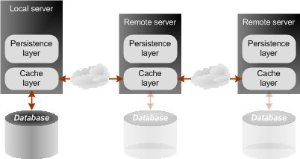
Performance: Caching 2
Persistence corp: Edge Extend
Efficient cache synchronization allows virtual database

Slide 16
Performance: Lazy loads
An object might be very big
  Organization
  Car
Loading all at once is not practical
  So load it as you need it
  Flag objects as you go
  Byte code enhancement helps

Slide 17
So build your own services
Why not build POJO + services?
  Build your own mapping
  Caching
  Lazy loading
Because it’s hard
  At least, it can be

Slide 18
Agenda
Solution 1: Tactical POJO
Solution 2: EJB
Solution 3: OR Mappers
Solution 4: JDO
Solution 5: Open Source
Solution 6: Strategic POJO
Wrap up

Slide 19
Solution 2: EJB
Component oriented model
Default choice for EJB
Troubled history
  But has seen some improvement

Slide 20
History: EJB 1.x
EJB 1.0 was introduced in October 1998
  EJB 1.1 followed in December, 1999
Intention: Nirvana
  Fully distributed persistent entities
  Transparent distribution as needed
Realities
  Not ready
    Deployment, security, persistence stories incomplete
    Portability problems
  Massive performance problems
    Lacked local interfaces
    Lacked relationship management
  Most applications developed with BMP

Slide 21
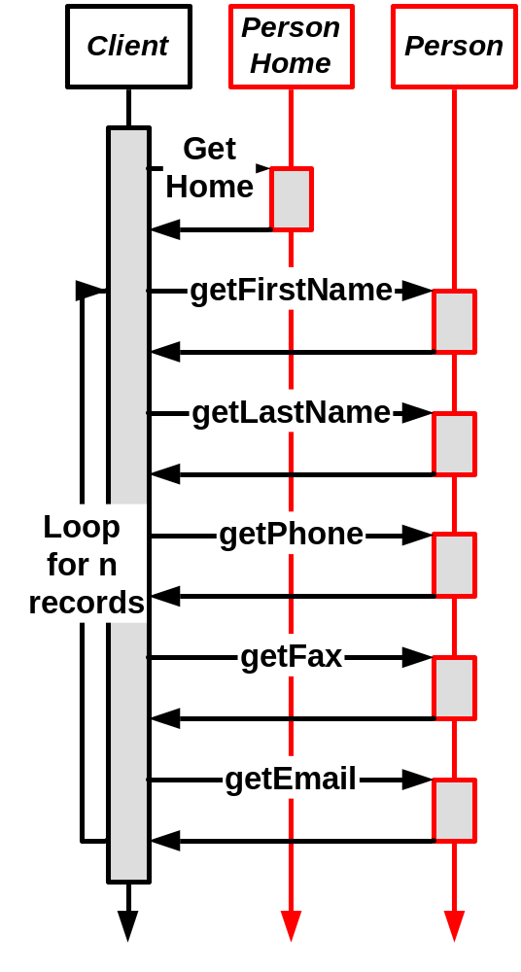
Round-tripping: Scenario
Remote client accesses EJB
EJB is not local
Communications costs are prohibitive

Slide 22
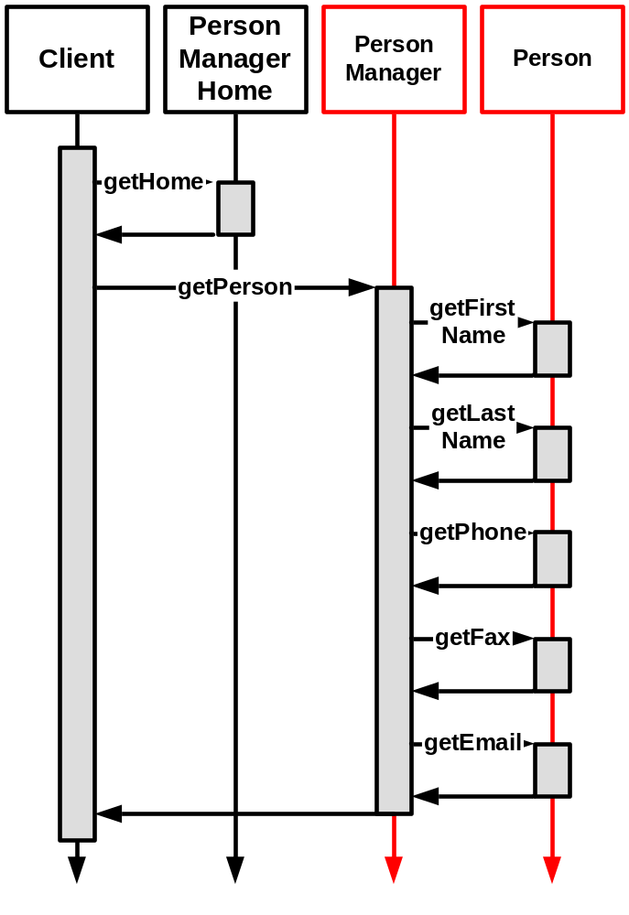
Apps now use façades
Remote client accesses facade
The façade is a coarse-grained interface
Façade provides:
  Distribution
  Transaction context
  Security
  Performance

Slide 23
Currently: EJB 2.x
EJB 2.0 was introduced in October 2001
Fixed some of the major problems
  Local interfaces allow better performance
  Container-managed relationships reduce application joins
Most applications still use a façade
Many problems still exist
  Container overhead. Both façade and entity support
    Transactions, security, potentially distribution
  Model is limited
    No component inheritance, abstract classes
    Artificial restrictions forced by EJB spec

Slide 24
EJB 2.x Concerns
EJB 2.0 changes torpedo philosophical advantages
Local interfaces
  Require deployment of all beans with local interfaces
  Now persistent components have different interfaces
CMR: It’s no longer a component model.
  EJB QL: Deploy time binding!
  Meta-component comprised of other components? No
    Can’t rely on the EJB component deployment

Slide 25
Fundamental problems
Model flexibility
  EJB definition of reentrant class is not on method level
  No inheritance (component inheritance)
Transparency
  Entities are too different from Java objects
Binding flexibility
  Queries are bound at deploy time
Coarse-grained architecture for fine-grained problem
  Performance
  Clarity of model

Slide 26
Duplicated services
Container
Session
Container
services
façade
Services
Security
Distribution
Perssitent
component
Persistence
Xact
Awareness
EJB Container

Slide 27
Wasted services
Employee Façade
Emp Entity
Address Entity
Client
Dist
Security
XAct
Emp
X-
Sec
Ejb
X-
Sec
Ejb
Mgr
act
act
Useful services
Wasted services

Slide 28
The right way
Employee Façade
Client
Dist
Security
XAct
Emp
Employee
Address
Mgr
0

Slide 29
Benefits of EJB
Political support
Standard support
Solutions for some problems
Ongoing investment
Sharing the model

Slide 30
The bottom line
Model is much too limited
  Not transparent
  No inheritance, abstract classes
  Reentrance, threading limitations
Service is poorly packaged
  Coarse-grained service
So many look elsewhere

Slide 31
Agenda
Solution 1: Tactical POJO
Solution 2: EJB
Solution 3: OR Mappers
Solution 4: JDO
Solution 5: Open Source
Solution 6: Strategic POJO
Wrap up

Slide 32
Solution 3: OR Mappers
A couple of good ones exist
  TopLink
  CocoBase
They specialize in mapping
Have optional object models
  EJB-lite model
    Persistence EdgeExtend
  Or transparent model
Focus on
  Mapping
  Performance extensions

Slide 33
Solution 3: OR Mappers
TopLink
  Lots of market share
  Fast, flexible
  Exceptional relational mapping
CocoBase
  Moderate market share
  Fast, good relational mapping
  Recent deal with IBM

Slide 34
OR mappers down side
Typically very high cost
No clear leader
  TopLink:
    Oracle bought them
    Support for servers, DBMS is unclear
Proprietary
  Vendors can and do get in trouble
  Changing dynamics
Infighting
  CocoBase (see TheServerSide: EJB vs JDO)

Slide 35
Agenda
Solution 1: Tactical POJO
Solution 2: EJB
Solution 3: OR Mappers
Solution 4: JDO
Solution 5: Open Source
Solution 6: Strategic POJO
Wrap up

Slide 36
Solution 4: JDO
Open standard for Java persistence
Spec about 1 year old

Slide 37
JDO is…
JDO is…
A persistence framework specification
Sits on top of relational and non-relational databases
Object oriented
  Not component oriented
Transparent
  Usually achieved through byte code enhancement

Slide 38
About the JDO Spec
Created via Java Community Process (JCP)
Java Specification Request JSR-000012
Defines abstract API for Transparent Persistence
  Integrates with application servers
  Allows multiple data stores, from flat files to OODBMS
Schedule:
  Expert Group Formed August 1999
  Participant Review Draft May 2000
  Public Proposed Final Draft May 2001
  Accepted by Vote 14-0 March 2002
  Final Specification 1.0 April 2002
  Reference Implementation April 2002
  Test Suite April 2002
Notes:
There are two major objectives of the JDO architecture: first, to provide application programmers a transparent Java-centric view of persistent information, including enterprise data and locally stored data; and second, to enable pluggable implementations of data stores into application servers.
The Java Data Objects architecture defines a standard API to data contained in local storage systems and heterogeneous enterprise information systems, such as ERP, mainframe transaction processing, and database systems.
The architecture also refers to the Connector architecture which defines a set of portable, scalable, secure, and transactional mechanisms for the integration of EIS with an application server. This architecture enables a local storage expert, an enterprise information system (EIS) vendor, or an EIS domain expert to provide a standard data view (JDO Implementation) for the local data or EIS.
As you can see by this schedule, the JDO spec has been 3 years in the coming and is a very well-thought out specification.

Slide 39
JDO code: Employee.java
public class Employee
extends Person
{
private float salary;
private Company company;
private Set projects = new HashSet ();
public Employee (String firstName, String lastName)
{
super (firstName, lastName);
}
public void giveRaise (float percent)
{
salary *= 1 + percent;
}
public Collection getProjects ()
{
return projects;
}
Notes:
The key thing to note here is that the source file doesn’t include any data store infrastructure code.

Slide 40
Employee.jdo
<?xml version="1.0" encoding="UTF-8"?>
<jdo>
<package name="com.solarmetric.example">
<class name=”Employee” persistence-capable-superclass=“Person”>
<field name=”projects">
<collection element-type=”Project" />
</field>
</class>
</package>
</jdo>
<extension vendor-name=“kodo” key=“table” value=“EMPLOY_T” />
Notes:
Normally, when you think of an XML file, you expect something very complicated. Here you can see that the persistence descriptor is a relatively straight-forward and easy to use.

Slide 41
JDO Enhancement
Source File
MetaData Tool
JDO libraries
JDO Enhancer
Enhanced Class File
Javac
Class File
Metadata
Metadata
SchemaTool
RDBMS
Reverse Schema Mapping Tool
Notes:
Enhancement is not required by the specification. You could write the 9 methods that make up the enhancement yourself.
If you go with an enhancer like Kodo JDO, that’s all you need. Just your normal source file and your normal persistence descriptor.

Slide 42
JDO Public Interfaces
PersistenceManagerFactory: Factory for obtaining configured PersistenceManagers
PersistenceManager: Persistence controller and factory for Transaction, Query
Transaction: Replaced by sessions with EJB
Query, JDOHelper, PersistenceCapable, InstanceCallbacks: Other types of support

Slide 43
JDO Query Language
Basic Query:
String filter = "salary > 30000";
Query q = pm.newQuery (Employee.class, filter);
Collection emps = (Collection) q.execute ();
Basic Query with Ordering:
String filter = "salary > 30000";
Query q = pm.newQuery (Employee.class, filter);
q.setOrdering ("salary ascending");
Collection emps = (Collection) q.execute ();

Slide 44
Benefits of JDO (General)
No need to write persistence infrastructure
  No hand-coded SQL
Standard means of persisting objects
Portability between data stores
Light weight

Slide 45
Benefits of JDO (modeling)
Does not limit the object model
Full support for Object-Oriented concepts
  Abstract classes
  Inheritance
  Loops in calling graph
Reports of a 20 - 40% decrease in persistence coding time
Notes:
The best way to start thinking about JDO is to talk about the benefits of it.

Slide 46
Extensions add value
Example: SolarMetric’s Kodo
Caching features provide > 10x boost
  Compared to standard JDO
  Distributed cache allows high scalability
Supports most JDO specification optional features
Supports many databases, application servers

Slide 47
JDO: The down side
Byte code enhancement
  Stepping over line of trust?
Political affinity
  OODBMS like them
  RDBMS don’t
Still very young

Slide 48
Agenda
Solution 1: Tactical POJO
Solution 2: EJB
Solution 3: OR Mappers
Solution 4: JDO
Solution 5: Open Source
Solution 6: Strategic POJO
Wrap up

Slide 49
Solution 5: OpenSource
Hibernate
  Very popular now
  Good reputation, #1 SourceForge persistence
  Not many deployments
  Issues? Lazy load + inheritance?
Castor JDO
  Problematic, not too scalable, JDO name only
JDO?
  No truly scalable alternatives yet, but growing

Slide 50
Agenda
Solution 1: Tactical POJO
Solution 2: EJB
Solution 3: OR Mappers
Solution 4: JDO
Solution 5: Open Source
Solution 6: Strategic POJO
Wrap up

Slide 51
Solution 6:Strategic POJO
Roll your own
Better access to SQL
Build it once
Customize it
AOP? Crosscutting concern…
Want to see SQL from persistence fw?
  IronEye SQL from IronGrid

Slide 52
Agenda
Solution 1: Tactical POJO
Solution 2: EJB
Solution 3: OR Mappers
Solution 4: JDO
Solution 5: Open Source
Solution 6: Strategic POJO
Wrap up

Slide 53
Conclusion: Politics
EJB has investment, big name support
  But lots of negative energy too
JDO has OODBMS support
  Where are the big DBs?
  Byte code enhancement problems
  Need some momentum
Relational mappers
  OR acquisition uncertainties
  CocoBase hates JDO, is very vocal
  OR vendors in general don’t like JDO
Hibernate is OpenSource darling

Slide 54
Conclusion: Which one?
No silver bullet: take best fit
A few bad answers
  Technology (EJB, Castor, etc)
  Politics, future concerns (TopLink w/ DB2 or BEA)
Some promising young technologies
  JDO
  Hibernate
Some tactical solutions
  Persistence EdgeExtend
Some important features
  Synchronized, distributed cache
  Lazy loading

Slide 55
Conclusion: Wrap up
Evaluations!
J2Life, LLC
  bruce.tate@j2life.com
  Design reviews
  Persistence and performance consulting
  Developer marketing
Read more in Bitter EJB, available in June
  www.manning.com/tate2 to register
New project: Object persistence book

